Slide 1
Wireless Communications

Slide 2

Agenda
Basic Concepts
Generation of Mobile Devices
How a Cell Phone System work?
Mobile Networks

Slide 3
Circuit and Packet Switching
Circuit-switched
  A physical path is obtained for and dedicated to a single connection between two end-points in the network for the duration of the connection.
Packet-switched
  Small units of data called packets are routed through a network based on the destination address contained within each packet. The same data path can be used by many users in the network. This type of communication between sender and receiver is known as connectionless (rather than dedicated).

Slide 4
FDMA,TDMA and CDMA
FDMA ( Frequency Division Multiple Access)
FDMA works by dividing the entire bandwidth into some channels
TDMA (Time Division Multiple Access)
TDMA works by dividing a radio frequency into time slots and then allocating slots to multiple calls. In this way, a single frequency can support multiple, simultaneous data channels. TDMA is used by the GSM digital cellular system.
CDMA (Code-Division Multiple Access)
Unlike systems that use TDMA, CDMA does not assign a specific frequency to each user. Instead, every channel uses the full available spectrum. Individual conversations are encoded with a pseudo-random digital sequence.

Slide 5
1G (Analog)
Uses frequency division multiple access (FDMA) to communicate (every call in one area uses its own set of channels for communication)
No support for wireless data
Support voice communication

Slide 6
2G (Digital)
Uses digital encoding and includes CDMA, TDMA and GSM. Text messages can be sent on 2G networks, but more bandwidth hungry applications require 2.5G.
Circuit switched
In the United States, GSM, TDMA, and CDMA are assigned two frequency ranges that include the frequency ranges assigned to analog cellular, 824 MHz to 849 MHz and 869 MHz to 894 MHz, and also the frequency ranges of 1850 to 1910 MHz and 1930 MHz to 1990 MHz.

Slide 7
2G (Digital)
GSM (Global System for Mobile Communications) is the digital transmission technique widely adopted in Europe and supported in North America. GSM uses 900 MHz and 1800 MHz in Europe. In North America, GSM uses the 1900 MHz band.

Slide 8
2.5G
An enhancement to 2G networks that allows them to operate in a "packet switched" manner
2.5G networks incorporate 2G technology with GPRS' higher speeds to support data transport. 2.5G is a bridge from the voice-centric 2G networks to the data-centric 3G networks.
GPRS (General Packet Radio Service) is a radio technology for GSM networks that adds packet-switching protocols. As a 2.5G technology, GPRS enables high-speed wireless Internet and other data communications. GPRS networks can deliver SMS, MMS, email, games, and WAP applications.

Slide 9

3G
3G networks promise next-generation service with transmission rates of 144Kbps and higher that can support multimedia applications, such as video, video conferencing and Internet access. Both UMTS (WCDMA) and EDGE will support 3G services. 3G networks operate on a different frequency than 2G networks.

Slide 10
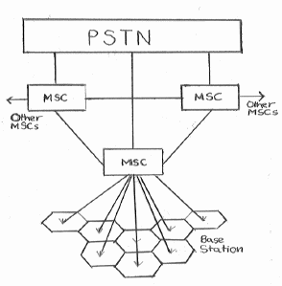
Cellular Networks
All BSs within a cluster are connected to a Mobile Switching Center(MSC).
Each MSC of a cluster is then connected to the MSC of other clusters and a PSTN main switching center.
The MSC stores information about the subscribers located within the cluster and is responsible for directing calls to them.

Slide 11
Making a Call
Scan Control Channels
Choose Strongest.
Send Origination Message which includes MIN ,ESN ,Dial Number
Get Channel Assignment
Begin Conversation

Slide 12
Roaming
If the HLR is a separate platform, or if the customer is visiting from another system, the switch then sends a data message to the HLR across the signaling network.
When the Home Location Register (HLR) receives the message, it checks the MIN & the ESN. If the numbers are valid, the HLR records the location of the phone and returns a message containing the subscriber's feature list and calling restrictions to the visited switch.
Once the visited switch receives the return message, it creates a Visitor Location Register (VLR) to store information about the roamer, including the MIN, ESN, features, etc... This register will be used by the roamer as long as they are registered in the visited system.

Slide 13
Hand-over
During a call, the base station would monitor the signal level from the mobile phone. When the mobile phone is moving into a new cell, the signal level will fall to a critical value causing the base station to inform the Mobile Switching Center(MSC) about this event. The MSC would instruct all the surrounding base stations to measure the mobile phone's signal level and transfer control to the base station receiving the strongest signal level. This is known as hand-over and occurs within 400ms, so the phone user is hardly aware of a break.
Registration is done again with the new base station. Location information stored in the MSC about this mobile telephone is updated. If the mobile telephone is moved into a cell belonging to a different cluster it would also have to register with the new MSC.

Slide 14

Cellular Data Networks
SMS
Short Message Service
MMS
Multimedia Message Service
GPRS
General Packet Radio Service

Slide 15
Short Message Service (SMS)
Globally accepted wireless service that enables the transmission of alphanumeric messages between mobile devices and external systems
Short Message Service Center (SMSC) acts as a relay and store and forward system for message
Active mobile handset is able to receive or send a short message at any time, independent of whether a voice or data call is in progress
Guarantees delivery of the short message by the network. Temporary transmission failures are identified, and the message is stored in the network until the destination becomes available

Slide 16
MMS
Multimedia Message Service, a store-and-forward method of transmitting graphics, video clips, sound files and short text messages over wireless networks using the WAP protocol. Carriers deploy special servers, dubbed MMS Centers (MMSCs) to implement the offerings on their systems.
MMS also supports e-mail addressing, so the device can send e-mails directly to an e-mail address.
MMS does not support attachments as e-mail does.
To the end user, MMS is similar to SMS.

Slide 17
GSM
This network is a global standard for mobile communication
It is circuit switched network
Supports voice communication
Limited data services
Charged even for idle time
It provides moderate speed data transfer, by using unused TDMA channels on a GSM network.

Slide 18
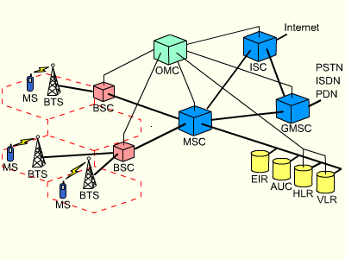
GSM Architecture

Slide 19
GSM Components
Radio System
Network and Switching System
Operation System

Slide 20
Radio System
Mobile Station (MS): The MS has all user equipment and software needed for communication with a GSM network.
Base Station Subsystem (BSS): A GSM network comprises many BSSs, each controlled by a base station controller (BSC)
Base Station Controller (BSC): The BSC manages the BTSs, it reserves radio frequencies, handles the handover from one BTS to another within the BSS
Base Transceiver Station (BTS): The BTS comprises all radio equipment, i.e., antennas, signal processing and amplifiers. One or multiple cells are formed by the BTS

Slide 21
Networking and Switching System
Mobile Services Switching Center (MSC): MSCs are high performance digital ISDN switches. They set up connections to other MSCs and to the BSCs, thus forming the fixed backbone network of a GSM system
Home Location Register (HLR): The HLR is the most important database in a GSM system as it store all user relevant information
Visitor Location Register (VLR): The VLR associated to each MSC is a very dynamic database which stores all important information needed for the MS users currently in the Location Area (LA) that is associated to the MSC.

Slide 22
Operation System
Operation and Maintenance Center (OMC): The OMC monitors and controls all the network entities. Typical management functions are traffic monitoring, status reports of network entities, subscriber and security management, or accounting and billing.
Authentication Center (AuC): A separate AuC has been defined to protect user identity and data transmission.
Equipment Identity Register (EIR): The EIR is a database which stores all device identifications registered for this network

Slide 23
GPRS
GPRS (General Packet Radio Service) is a specification for data transfer on TDMA and GSM networks. The theoretical limit for packet switched data is approx. 170 kb/s. A realistic bit rate is 30-70 kb/s. . GPRS supports both TCP/IP and X.25 communications.
It is a packet switching network
Allows wireless terminals to access IP Network
Billing is done based on the no of packets transmitted.

Slide 24
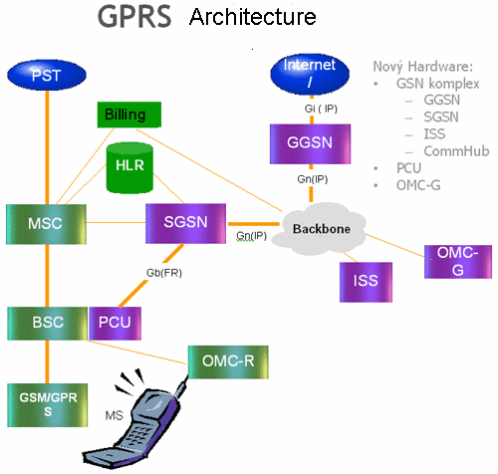

Slide 25
GPRS Support Nodes
SGSN (Service GPRS Support Node)
This functionality of this node is to transfer the data between two wireless terminals
GGSN (Gateway GPRS Support Node)
This node allows the wireless terminals to access the packet switching IP network.
.

